Slide 1
Customer Scatterplot
Helps to understand the Profit Margin of your company both geographically and by which customer, using a Geographical Map and Scatter Plot

Slide 2
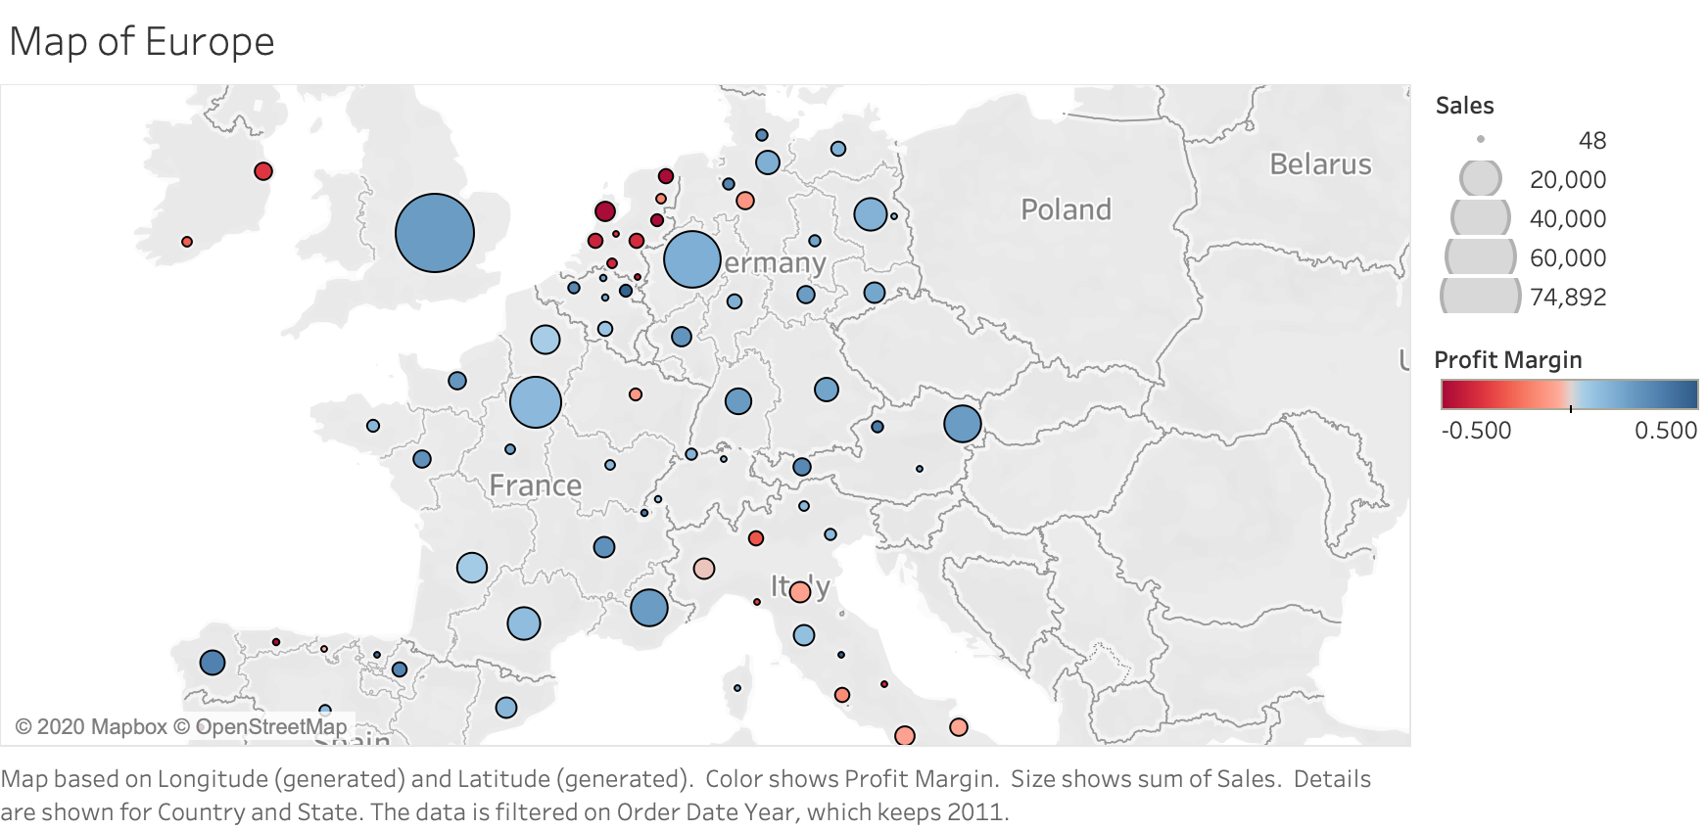

Slide 3
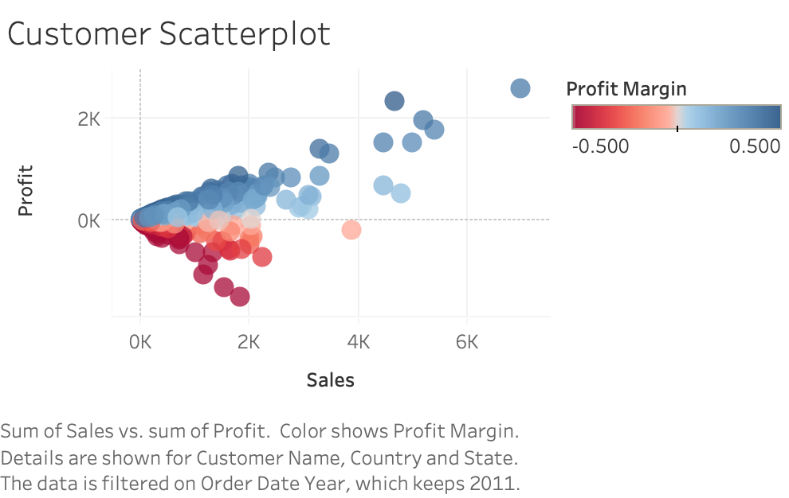

Slide 4
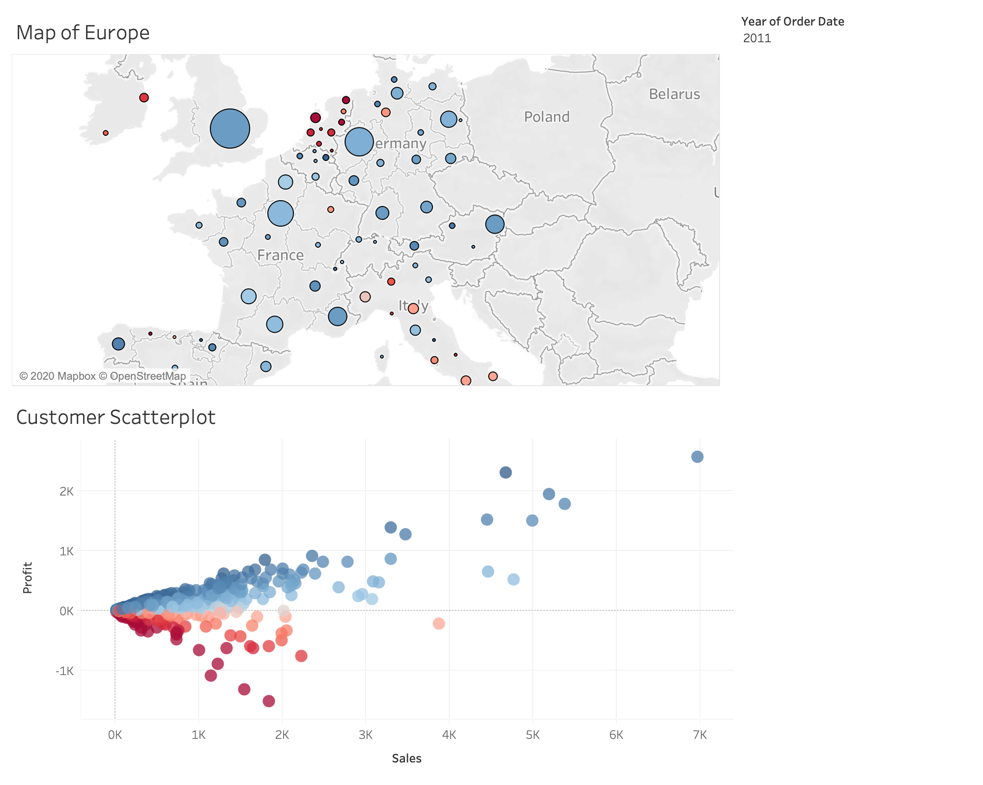
This dashboard allows you to easily see profit margin by region, and by customer. Move to the next slide to see how to interact with the dashboard and derive insight

Slide 5
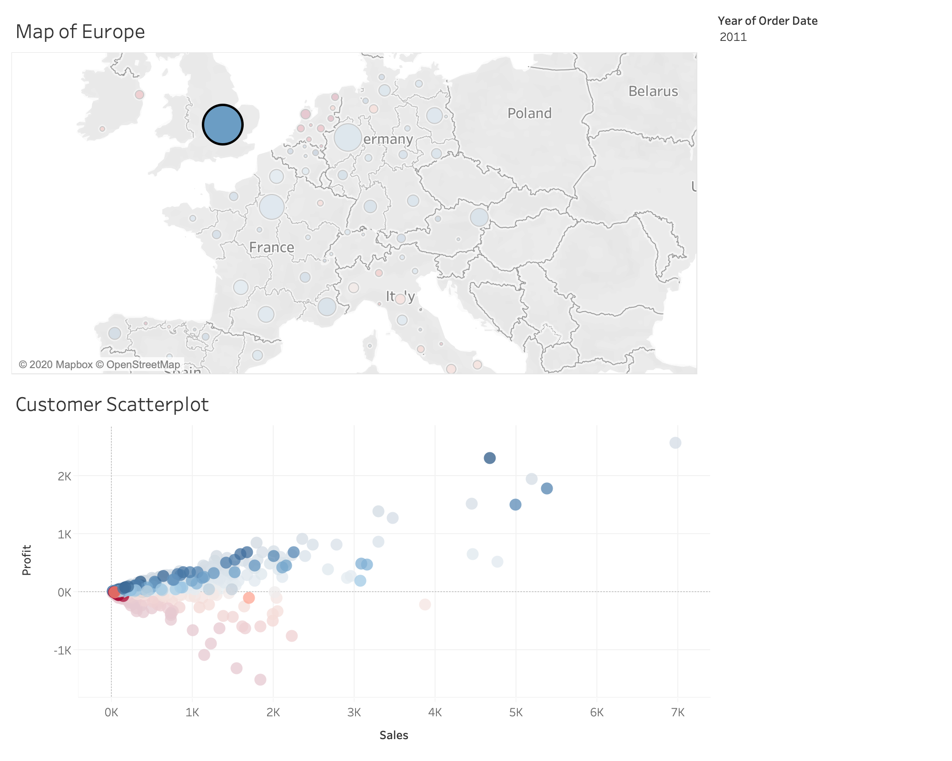
This dashboard allows you to drill down to specific regions, and it will filter the scatterplot by that region

Slide 6
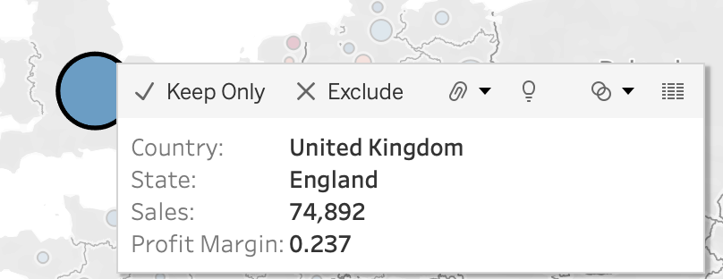
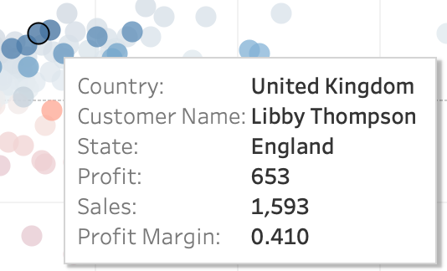
When hovering over the geo chart, you can see Country, State, Sales, and Profit Margin
When hovering over the customer scatterplot, you can see more data related to the specific customer

